Slide 1
How Low Water Conditions Affect Cold Tolerance In Pinyon Pine Resistant To Drought
By Benjamin M Ryan

Slide 2
Why its important

Slide 3
Pinyon are foundational species and have large impacts on biodiversity

Slide 4
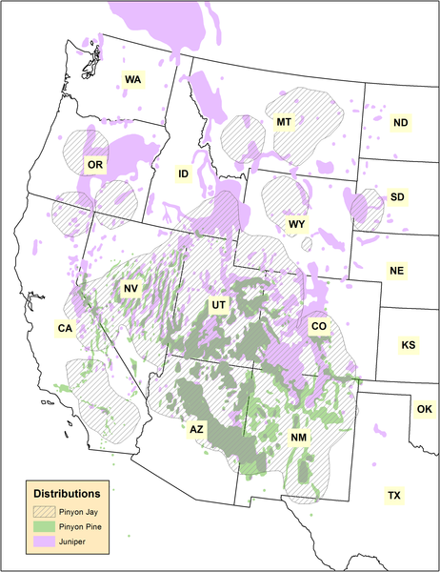
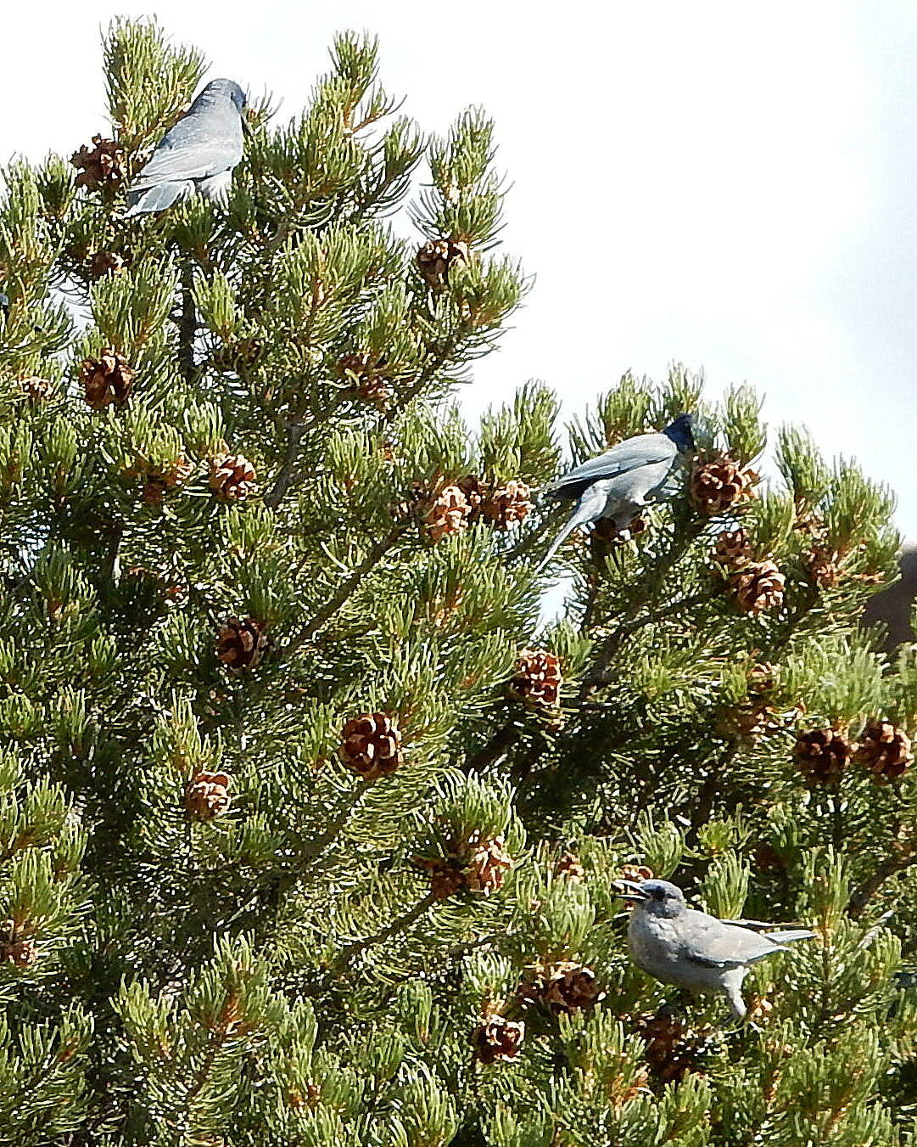

Slide 5
Drought and freezing are important determinants of plant distribution

Slide 6
Pinyon are experiencing high mortality primarily due to severe drought

Slide 7
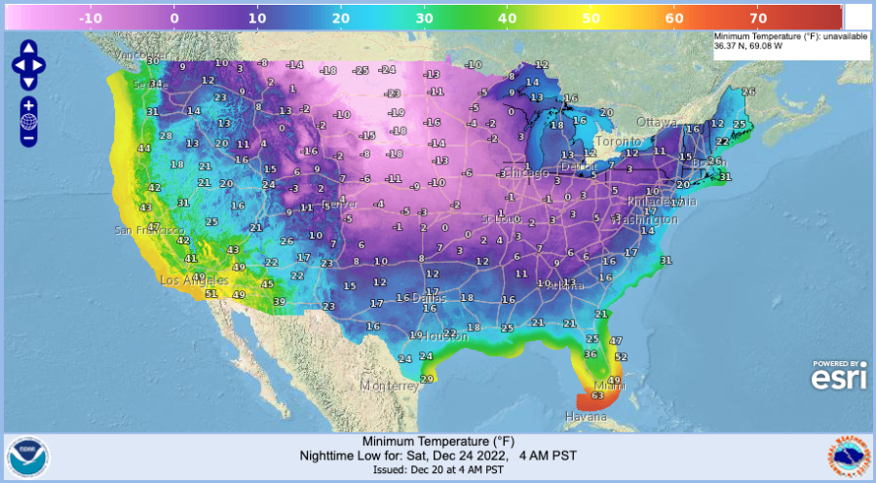

Slide 8
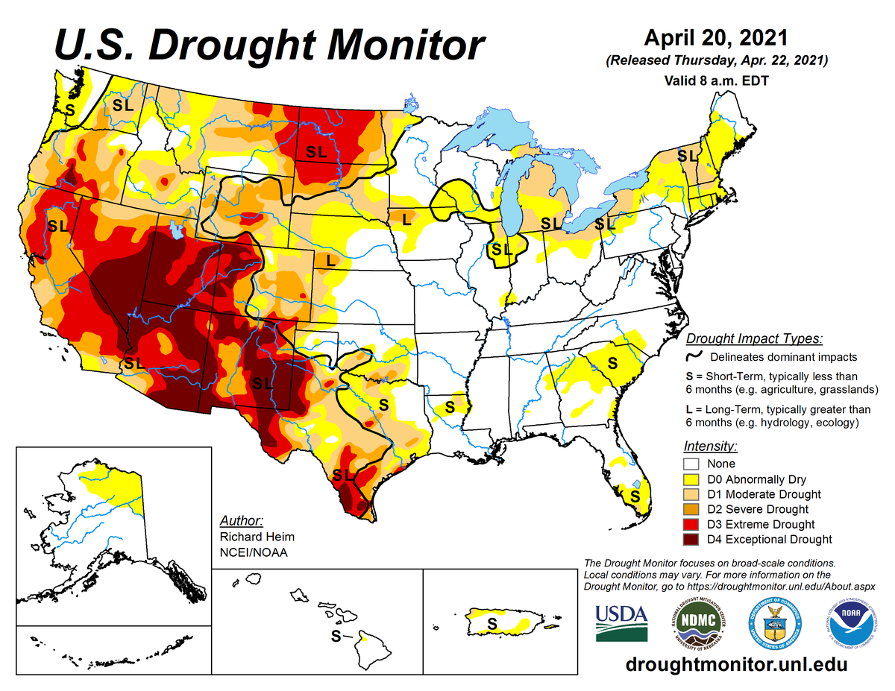

Slide 9
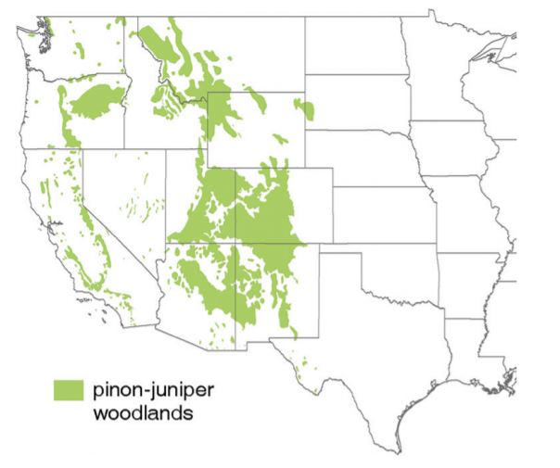

Slide 10
Death can occur under drought after just a single freezing event in saplings

Slide 11
Extent to which genetic drought resistance affects the range of cold tolerance is unknown

Slide 12
Hypotheses
I - The drought resistant trees will be less tolerant to cold.
Expected outcome due to possibility of a trade off for drought resistance and cold tolerance.
II - The drought resistant trees will be more tolerant to cold.
Possible due to drought and cold having similar physical effects, meaning there may be some overlap for drought and cold resistance.

Slide 13
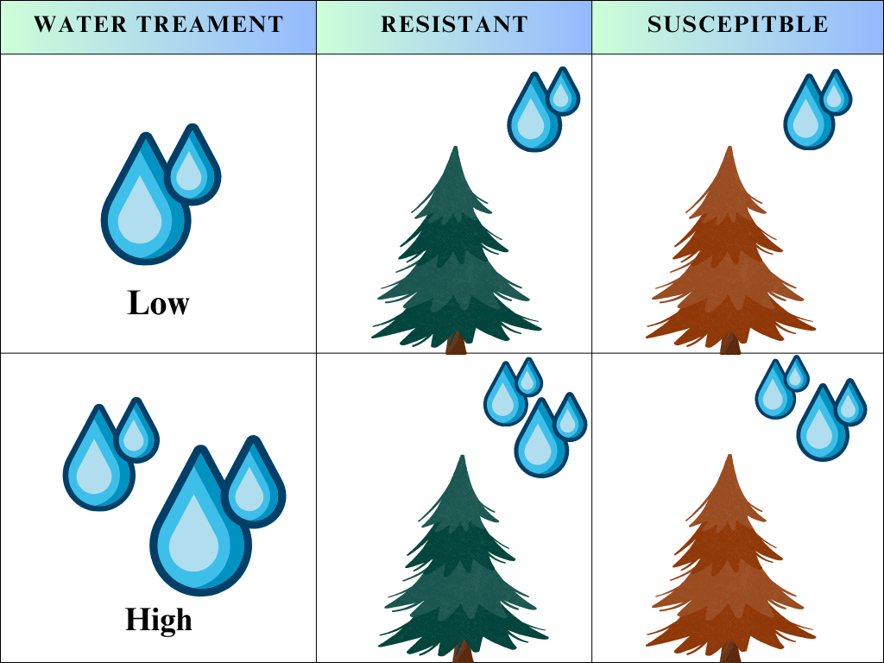
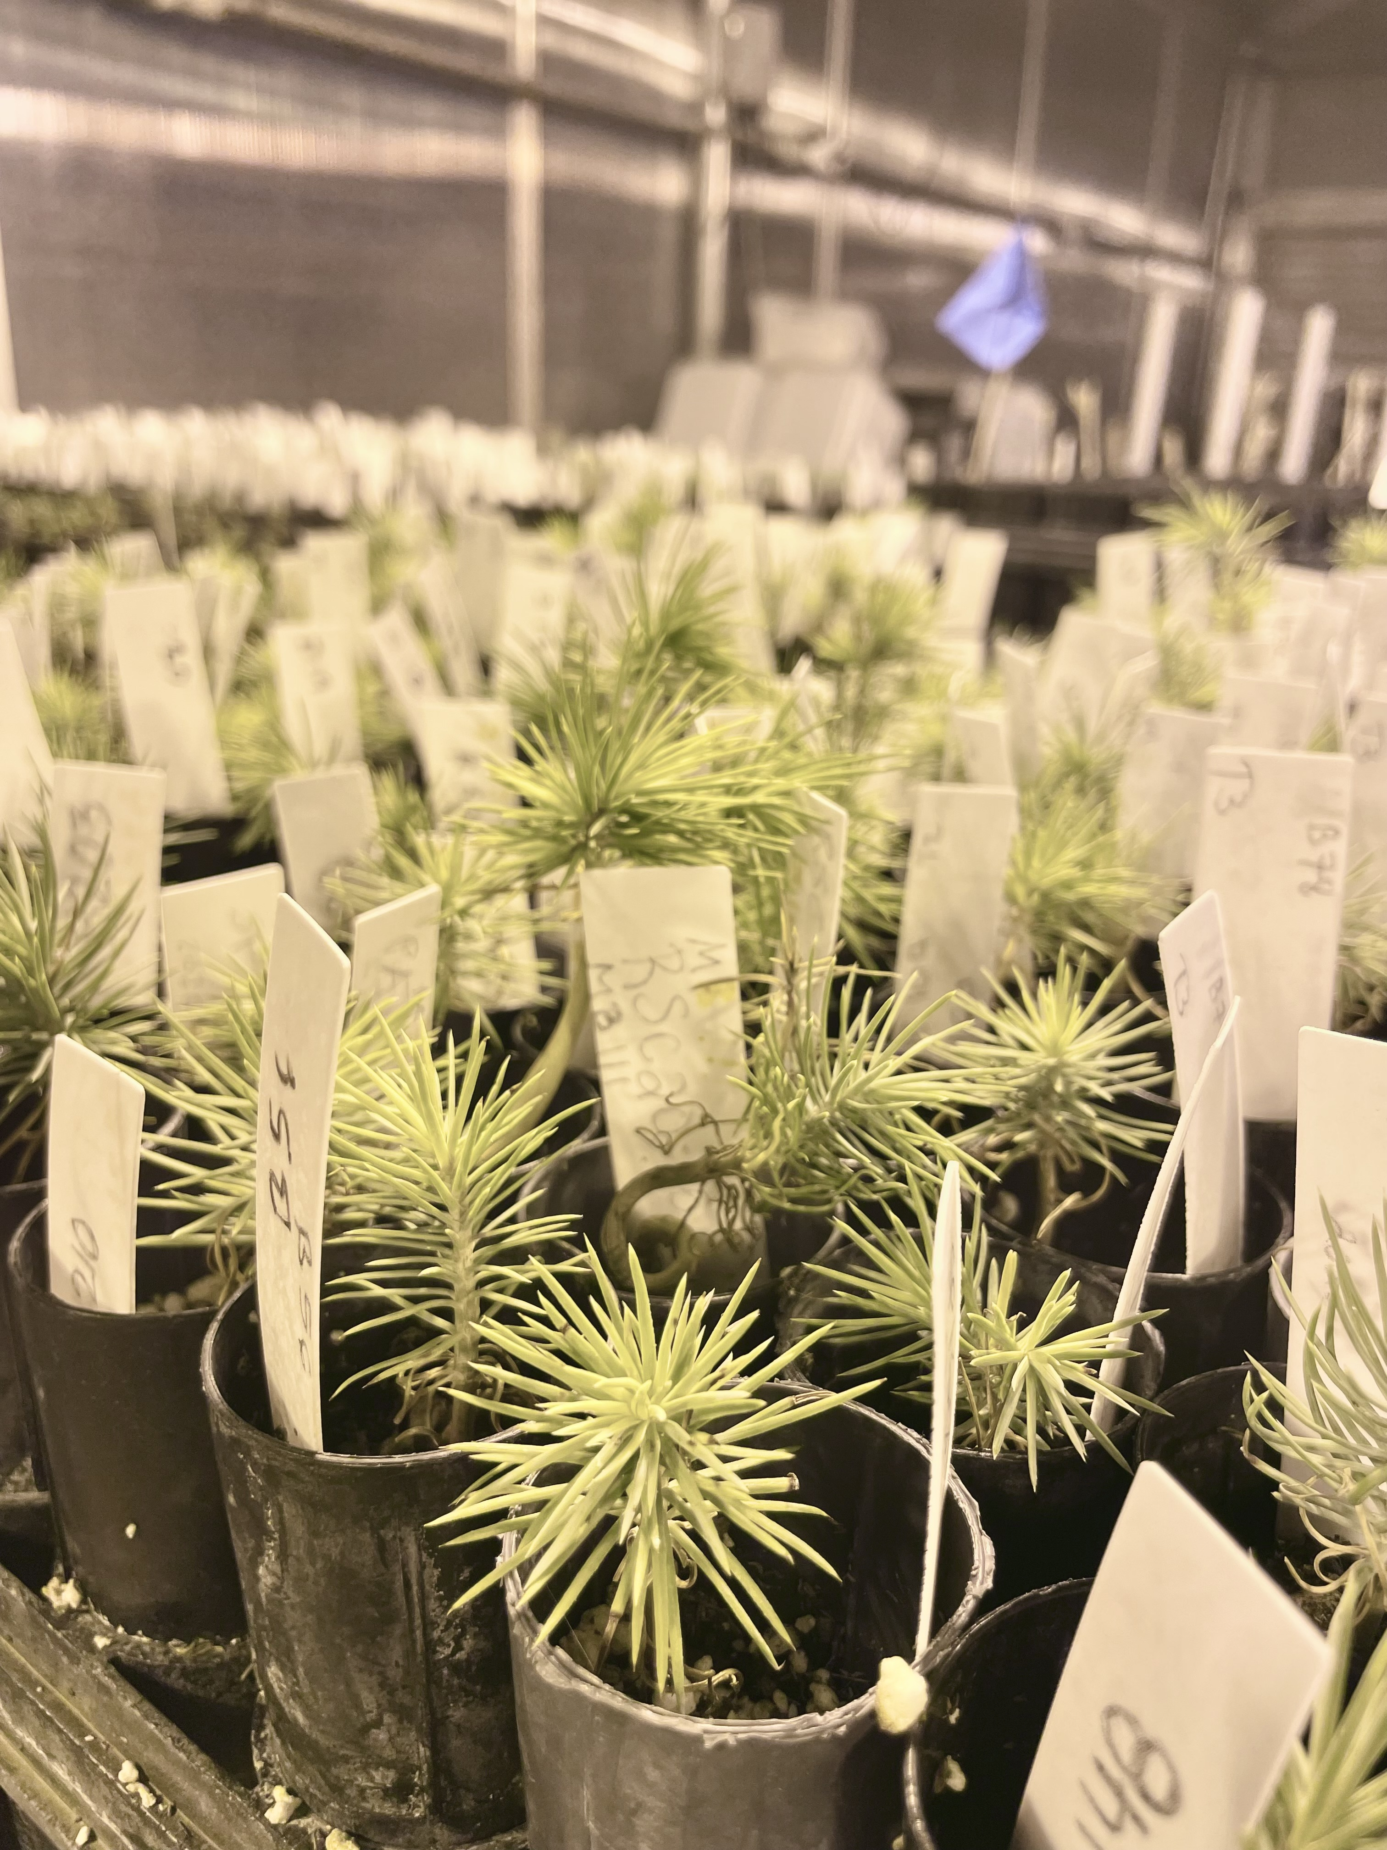
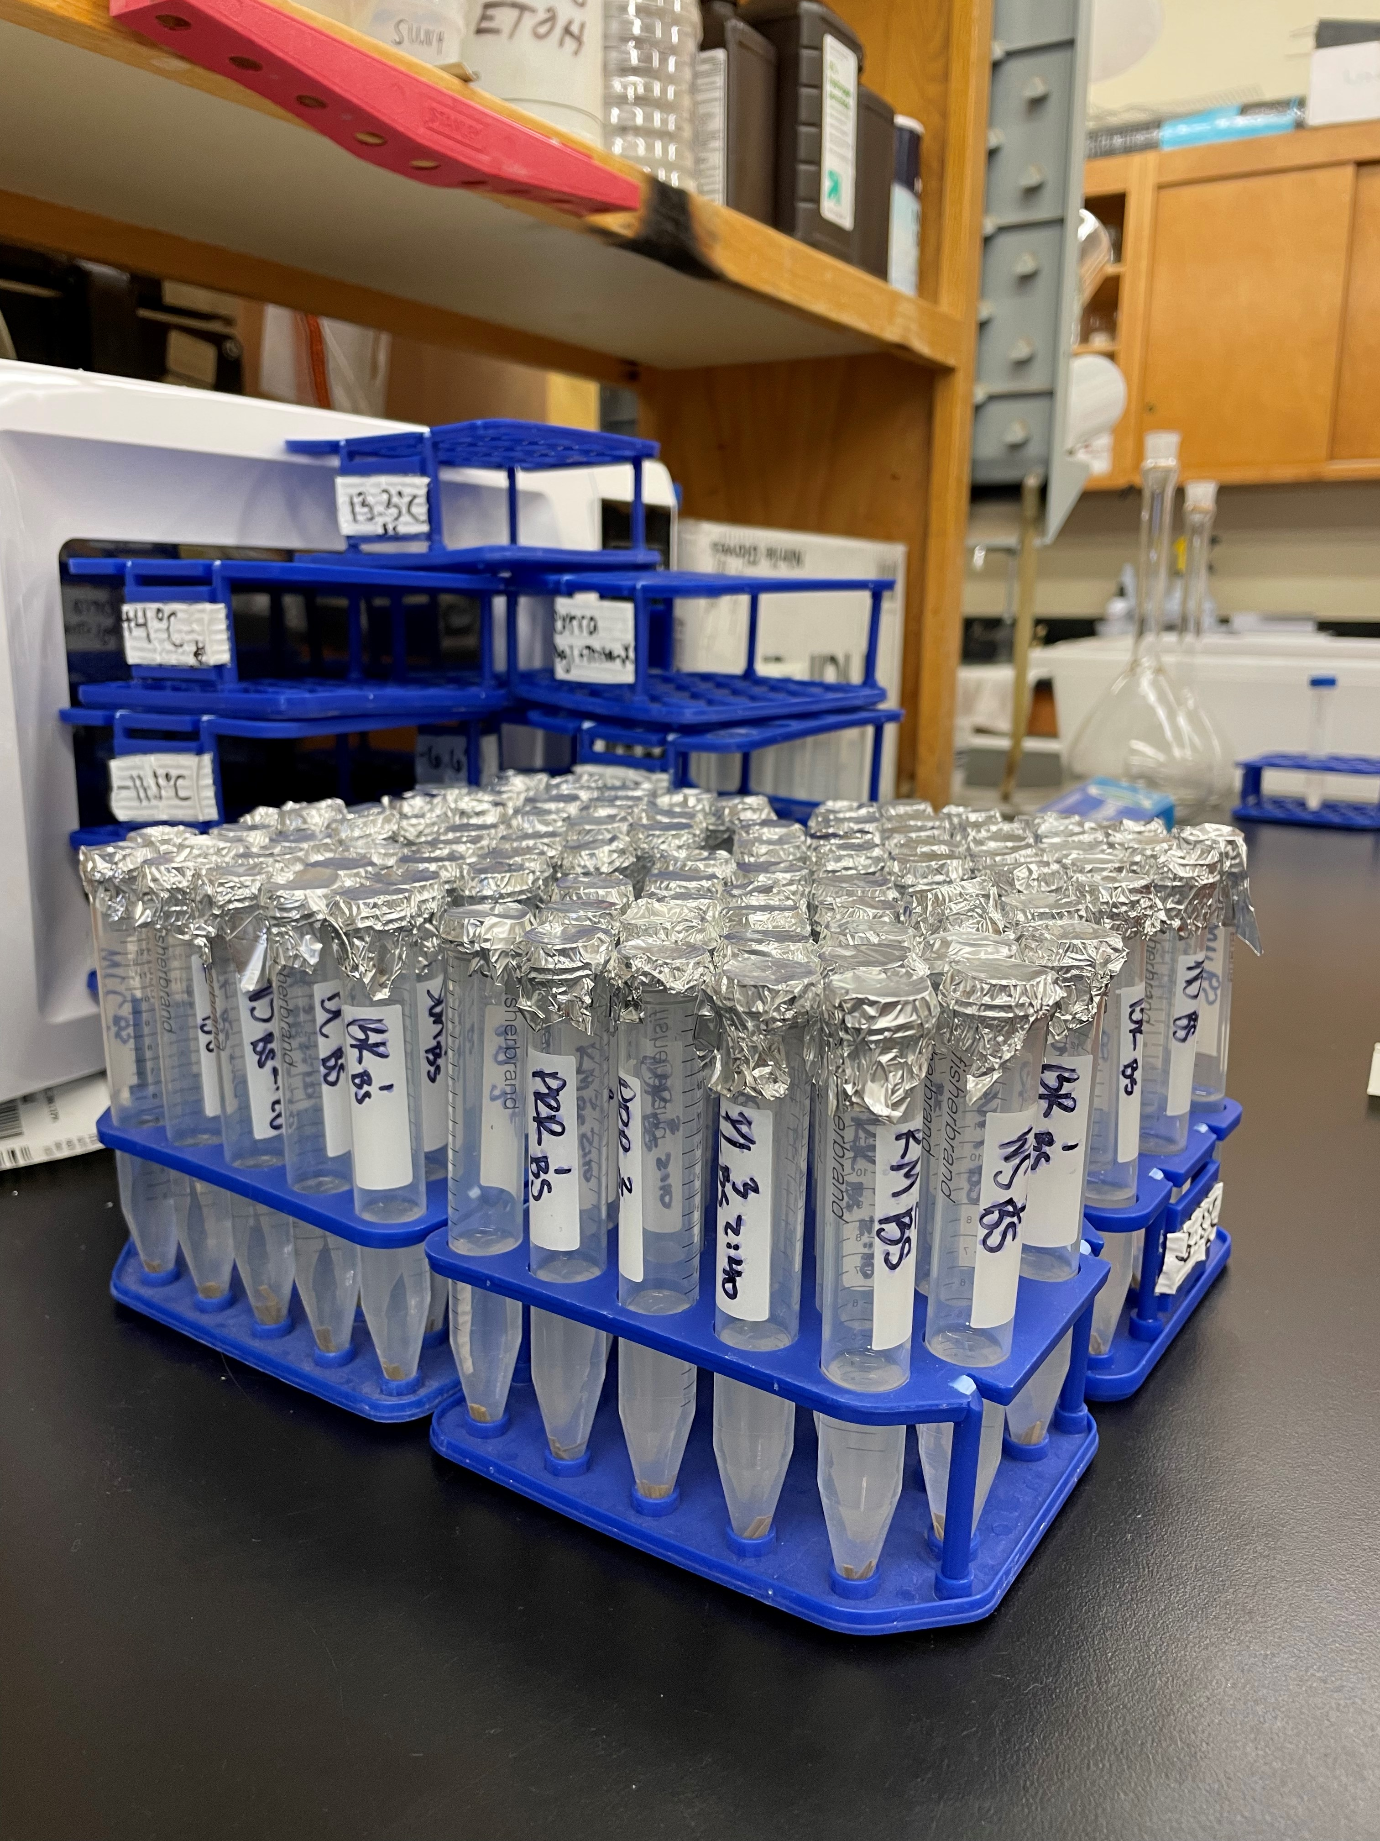
Experimental Design
Pinyon seeds were selected from the Sunset crater common gardens, that have been identified to either be drought resistant or drought susceptible
Each group was placed in a freezer then measured for electrolyte leakage (EL), which quantifies the amount of cell damage from freezing.

Slide 14
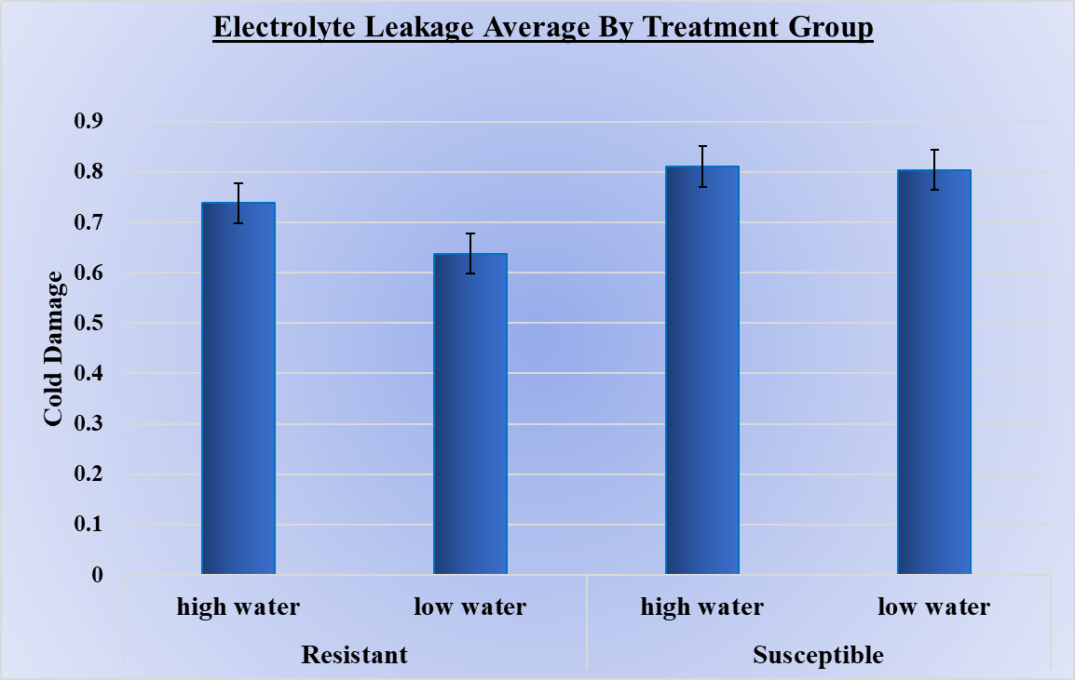
Results
** P = 0.004

Slide 15
Implications
Results show Drought resistant trees are statistically more cold tolerant.
More data is needed to determine the significance of the interaction between drought treatments.

Slide 16



Acknowledgements
Special thanks to Dr. Amy Whipple and my peers in the Pinyon Pine Research Lab

